Slide 1
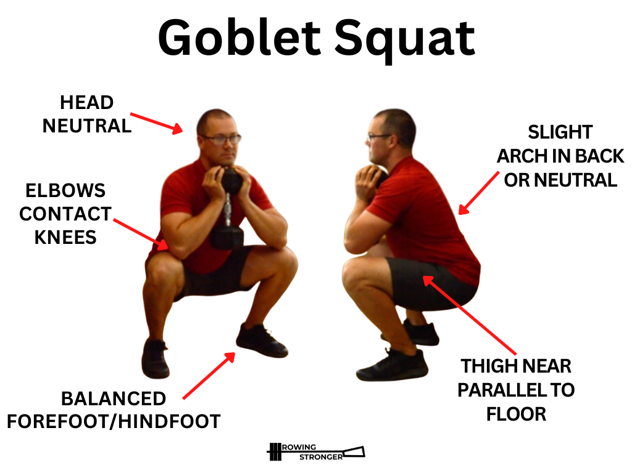
End to End Pipeline
Question: Should we use Vector database for this (RAG) or use a structured database or hybrid?
Questions for Mentor. Date 3-May-2026
Save record : S3, processed Mediapipe, processed video analysis
When User Uploads Video
Hosted in S3 Bucket
Passed through Mediapipe to get x,y,z
Python Script to convert Mediapipe to Biomechanics data
Specialised LLMfor video analysis (text output such as 10 reps, shoulder rounded)
LLM (Claude Sonnet 4.6) for Reasoning & Coaching
Nemotron 3 Nano Omni
Should we only pass biomechanics/ text into LLM or pass the video uploaded as well?
RAG/
Passed through Mediapipe to get x,y,z
Python Script to convert Mediapipe out to Biomechanics data (E.g Knee ANgle - 90%, Time taken to go down = 3 sec etc)
Nemetron for video analysis (JSON + Paragraph + timestamp + video)
20-30 Squat Videos
Save in a Vector Database/Regular DB
If just good tips are saved without reference image/video, can the LLM reason if that user’s video (knee angle etc) has good form?
10-20 Form Tutorial videos
Audio transcription to text (good form)
Some data are structured (e.g knee angle, some are unstructured e.g image, audio transcription) -- Do we need just vector DB or hybroed of vector + regular?
Images
Gemini Flash (form image & text)
User Data
Onboarding (e.g Past injury)
Weight input by user (for current video)
Past form analysis score, insights
Save in a structured DB
Notes:
LLM take the video and transcribe , and break it into specific data points → save in a relational database, or parent child retriever (video is the whole content, parts of it can be used for chunking..) JSON - exercise, no of reps (etc from mediapipe) → costs less for LLM to process, or written out paragraphs from m Hybrid retrieval → Qdrant (chunks → hybrid search on its own, sparse for exact match like “squat”, dont have to store it in vector DB)

